Slide 1
Exploring Your professional identity
Ashley Liddle
-Student Career and Skills Coach
-PhD Scholar-Practitioner

Slide 2
Aims and Objectives
By the end of this session, you will be able to:
Identify the skills, behaviours, and knowledge required to ‘be’ and ‘become’ a professional
Explore how employers look at your professional identity
Understand how to address employability as a ‘Scholar’
Practically assess your own competencies
Create a plan to showcase YOUR professional identity to prospective employers

Slide 3
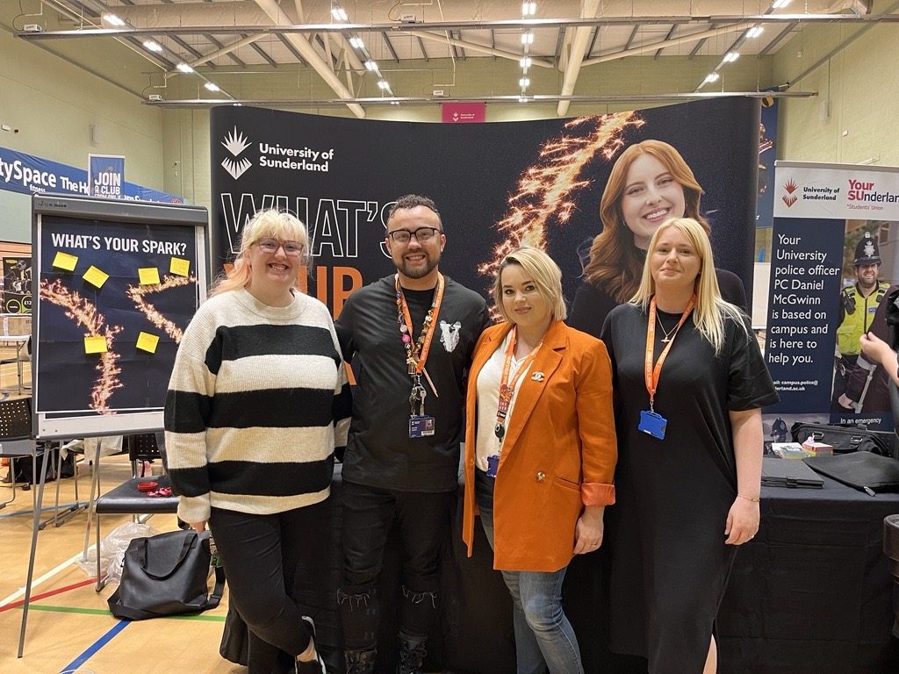
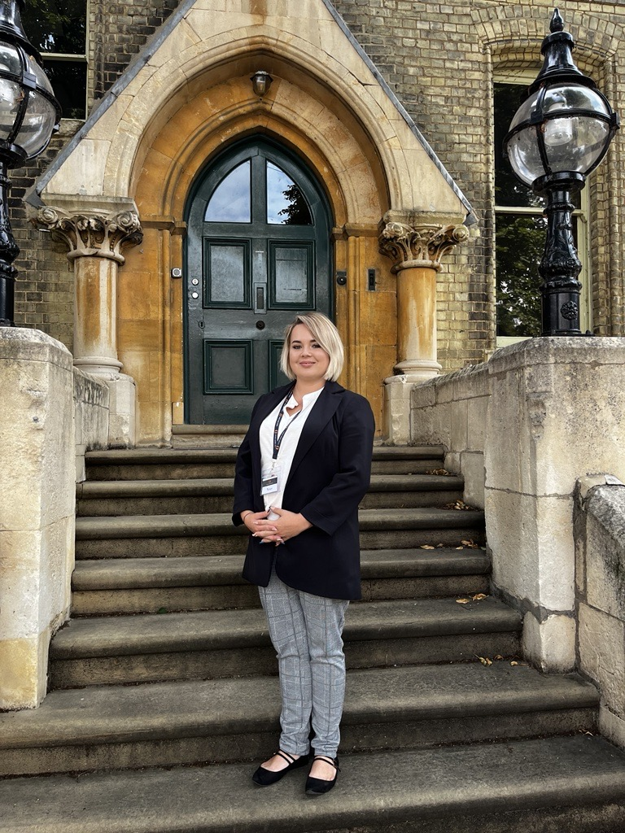
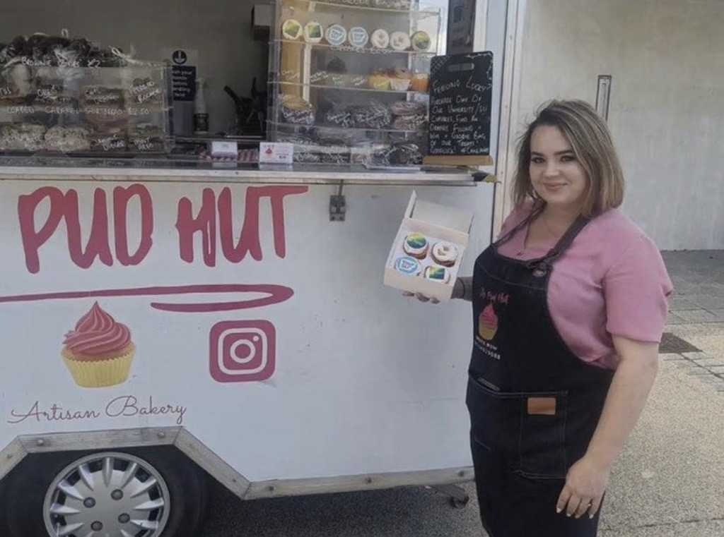
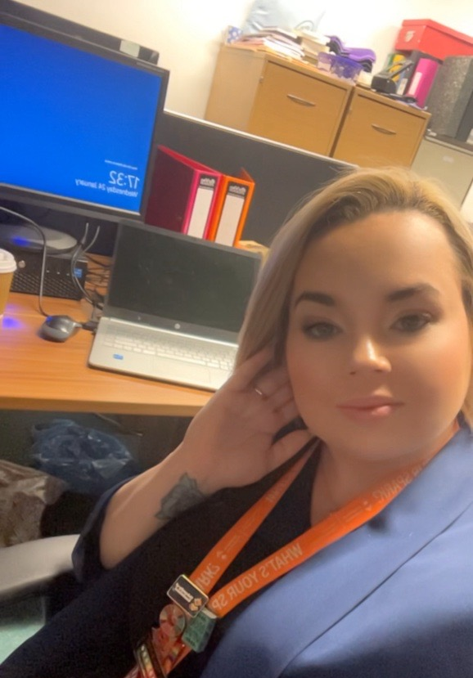
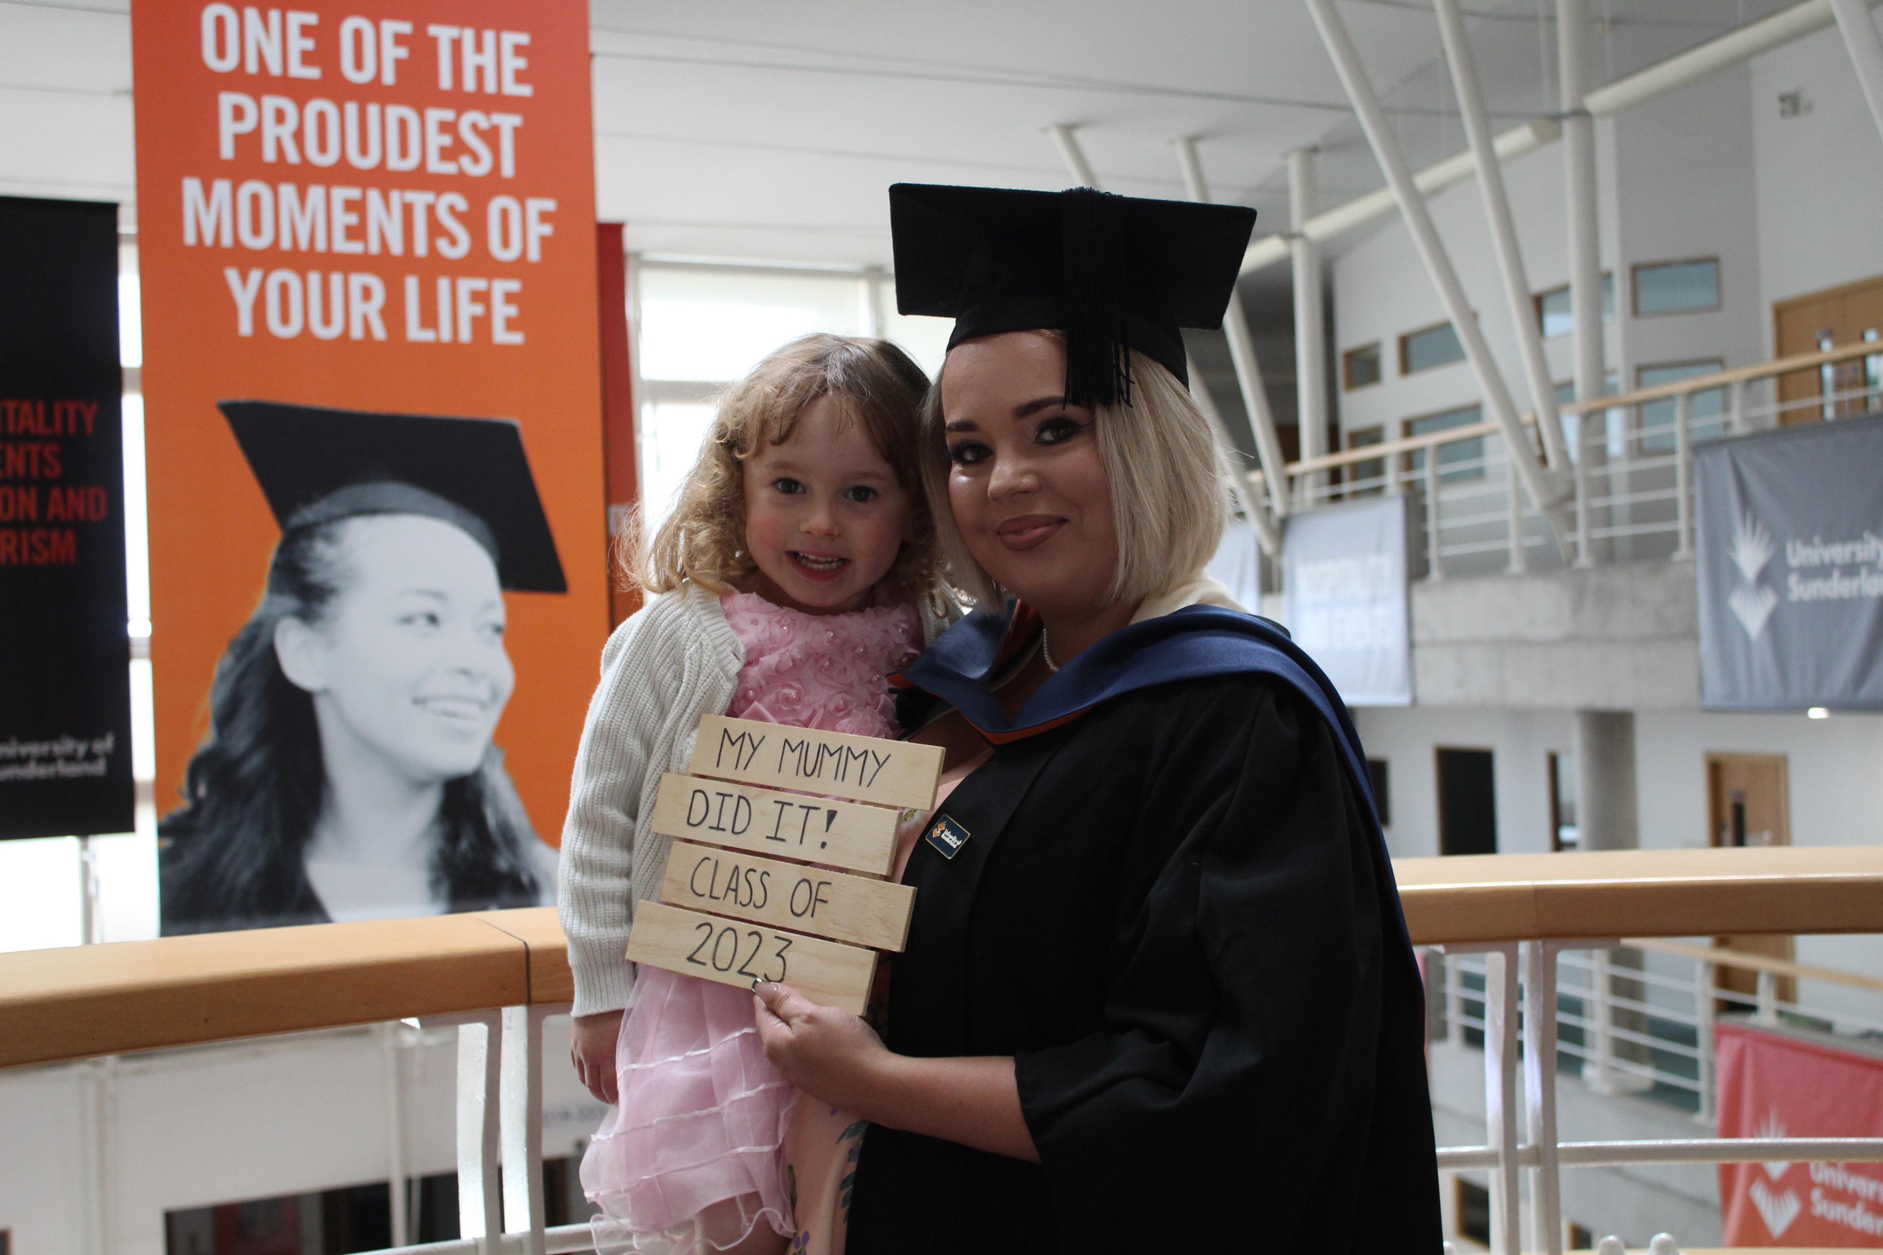
Who am i?
Student Career and Skills Coach Employability & Enterprise Hub
SME Owner
Educator
PhD Researcher
The Transitional Development of Educational Journeys: Scholar-Practitioner Identity Formation
2023 Graduate BA (Hons) Business and Applied Financial Management

Slide 4
Who are you?
In pairs, find someone you DO NOT know and in no more that 3 sentences provide a quick introduction to who you are and why you are here
NAME
ANY PROFESSIONAL EXPERIENCE YOU HAVE
WHERE YOU ARE FROM
WHAT DO YOU WANT TO DO BEYOND YOUR STUDIES
MOTIVATIONS FOR DOING YOUR COURSE

Slide 5
WHAT KNOWLEDGE, SKILLS AND Behaviour DO YOU possess?
Using the Sticky notes provided, write down what you believe you already have and stick them to the board at the front of the classroom

Slide 6
Notes:
Peer Led Q+A session where students have the opportunity to ask specific questions about employability prospects specific to their individual trajectory

Slide 7
What’s the difference?
THE ABILITY TO MODIFY BEHAVIOUR FROM A LIVED EXPERIENCE SELF-MASTERY
THE ABILITY TO APPLY KNOWLEDGE IN PRACTICE COMMUNICATE
MANAGE TIME
Knowledge
Behaviour
YOUR RESPONSE TO SKILLS AND KNOWLEDGE EMOTIONAL
PHSYICAL
THE SUM OF WHAT IS KNOWN FACTS
INFORMATION
Skills
Change
Notes:
Knowledge, skills, behaviour and change are sequential. Simply put: Knowledge is theoretical and answers the question of what
Skills are more practical and answer the question of how. Change however is very different….this is the product of mastering skills and responding to those as you develop. This is what we Call SELF-MASTERY To resolve this issue, agents need to know how to apply knowledge and develop it. This then becomes a skill; a skill that can be actively practiced to solve problems and become proficient. the response would be to be consistently practice this so behaviour change and it becomes more natural (unconscious) In contrast, recalling information or knowledge doesn’t necessary lead to the learner to become proficient.

Slide 8
Case Study
Customers are consistently having a negative experience with call centre agents Feedback highlights they lack empathy
Agents are scripted and aren’t allowed to deviate and this decreases human connectivity Managers believe it’s a training issue Reality:
Call centre agents don’t lack skills of how to read scripts or recall information.
Notes:
To resolve this issue, agents need to know how to apply knowledge and develop it. This then becomes a skill; a skill that can be actively practiced to solve problems and become proficient. the response would be to be consistently practice this so behaviours change, and it becomes more natural (unconscious) In contrast, recalling information or knowledge doesn’t necessary lead to the learner to become proficient. Students should present their proposed solution to decrease the negative experiences.

Slide 9
An employer's eagle eye
Does the candidate:
Match the Job Criteria : Essential/Desirable
Evidence Competence
Have Positive Character Traits
Understand Business Etiquette
Notes:
A CV in proof that a candidate has the self-awareness to demonstrate their skills
Match: Qualification and experience to meet the demands of the job
Competence: can you showcase this. Saying you have a keen eye for detail and then misspelling something.
Traits: the employer is evaluating if you will fit into the organisation culture
Business Etiquette: can you succeed in a professional role?

Slide 10
Skills to focus on…
Communication
Conflict resolution and negotiation
The ability to convey information in both oral and written form. This includes writing reports, giving presentations, e-mails, and taking an active role in meetings.
The ability to find satisfactory solutions that work for all parties involved in a dispute.
Clerical skills
Operating computer software, taking notes, bookkeeping, telephone skills, managing records and data entry.
Adaptability
The ability to rapidly learn new skills and behaviours in response to changing circumstances.
Time management
Problem-solving
The ability to accurately gauge how long a project will take and to organise tasks accordingly. You can indicate your transferable skills by describing them, with supporting evidence, within your description of a previous role.
Leadership
The process of devising solutions in an appropriate way (logical, creative or flexible) both individually and as part of a team. . This is often associated with creativity.
The ability to demonstrate the qualities of a leader by motivating and empowering others to work as a team and by confidently sharing their ideas and direction while communicating and delegating effectively
Commercial Awareness
Delegation
The ability to demonstrate your interest and understanding of a wider commercial environment in relation to an industry, organisation or role
Independent Working
The ability to assign tasks to other people.
The ability to work self-sufficiently on an assigned task
Notes:
When doing a self-assessment, it’s a good idea to list key skills you already have and try to identify when you’ve used them in practice. This will make your CV easier to write when showcase your ability to meet the needs of an organisation but also determine whether the organisation is a good fit for you. Things to consider are: Follow with a tutor led discussion where students identify what skills they think they have developed outside of their current education. work, volunteering, community groups ect.

Slide 11
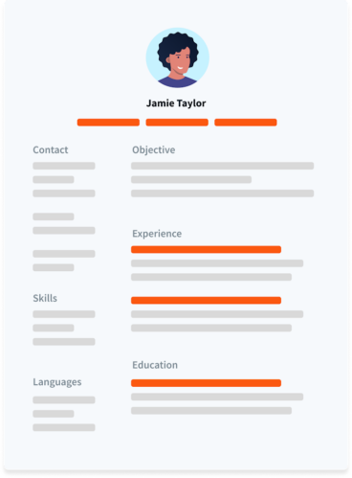
Your professional passport
Your CV/Resume serves 1 purpose:
A PROFESSIONAL SNAPSHOT FOR POTENTIAL EMPLOYERS
FACT: Employers typically make their first impression within 30 seconds of reading a candidates CV. SO MAKE IT COUNT!
Notes:
Your CV is the first point of call when showcasing your professional identity to potential employers. Identify areas where you think you need development of employability skills and make notes. These will help you in our next session tomorrow. Peer Led discussion

Slide 12
Your dreams aren’t big enough if they don’t scare you
To prepare for our next session, find and job vacancy/advertisement for your dream job and identify the knowledge, skills, and requirements the employer is looking for. Bring this with you tomorrow!

Slide 13
Aims and Objectives
You should now be able to:
Recognise the essential skills, behaviours, and knowledge necessary for establishing and evolving into a professional
Understand how employers perceive your professional identity
Understand how to address employability as a ‘Scholar’
Evaluate your own competencies in a practical manner.
Develop a strategy to effectively present your professional identity to potential employers.
Notes:
Make use of the Centre for graduate prospects. They have an array of services that support you on your journey to success. From CV support from coaches, to application advice from consultants, and even interview guidance. The centre are here every step of your journey, as a student and beyond. PATs, and Academics have the knowledge and connects in an array of fields and industries take advantage of their support and guidance throughout the term!
Attending these sessions will give you exclusive access to a canvas course that goes in more detail about how to craft your professional identity at a pace that suits you. If you haven’t already, be sure to scan your campus card on the reader and give Ashley your Student ID to be added.

Slide 14
Any Questions? and Thank you

